Slide 1






We4Tech
Track B- Analytics using Python
Non- Coders
Sahil Samir
PG-2
Ishojit Roy Choudhary
PG-2
Garima Rathi
BD
Ladi Amarnath Patro
PG-1
Shivang Jitendra Khare
PG-2

Slide 2


The Problem
“Analyze customer eligibility for home loan on various factors”
Factors affecting loan approval
Applicant Income
Co-Applicant Income
Credit History
Education
Employment
Gender
Marital Status
Loan Amount
Number of Dependents
Property Area

Slide 3
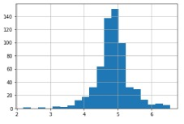
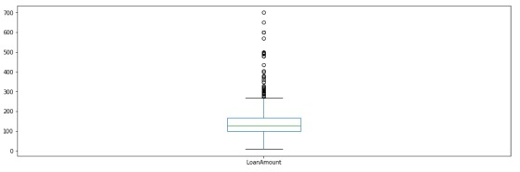
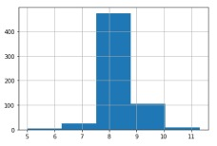
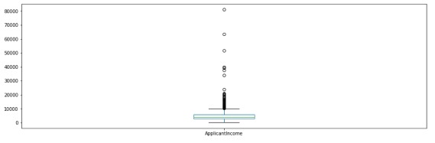
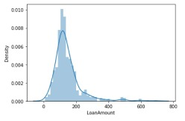
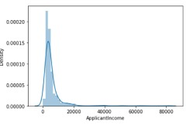
Removal of Outliers & Empty Heads
Before
Before
After
After
Loan Amount
Applicant Income

Slide 4
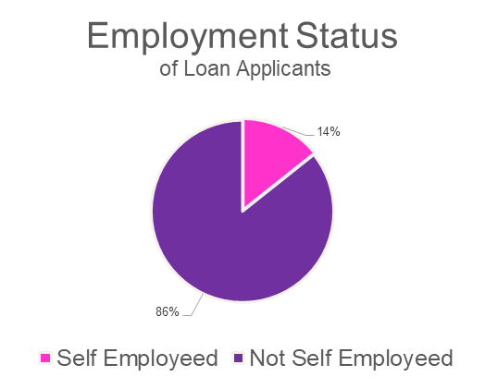
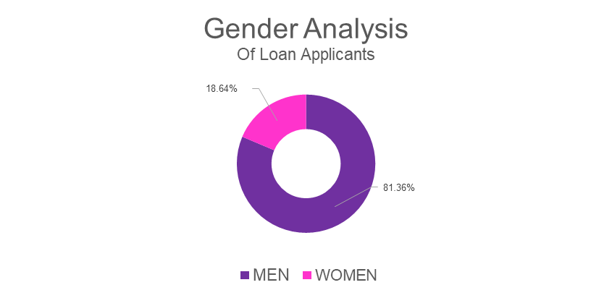
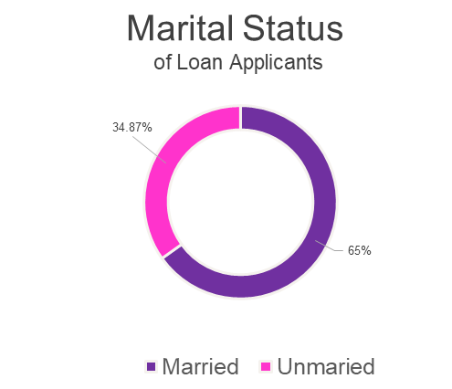
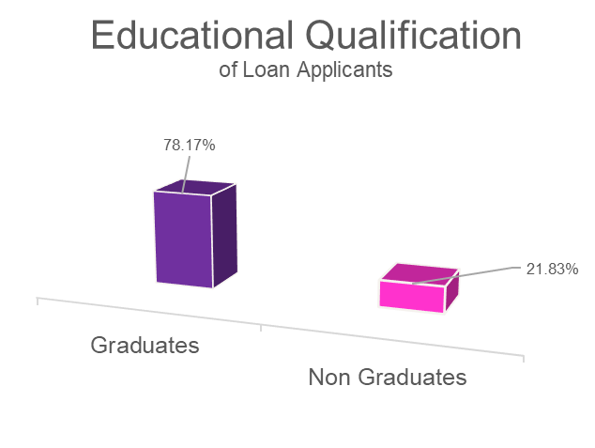
Uni-Variate Analysis of Loan Applicants
Inferences:
Click to 81.36% of the applicants were Male
65.13% of the applicants were married
14.03% of the applicants are Self-Employed
78.17% of the applicants are Graduates.
The Population of Semi-Urban was the highest.

Slide 5
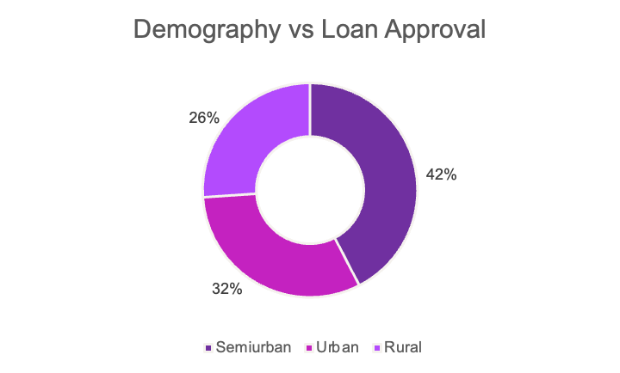
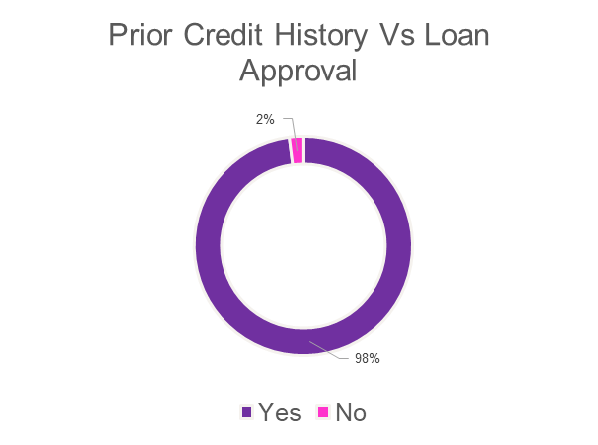
Bi-Variate Analysis of Loan Applicants​
Hypothesis Basis:
Income
loan amount
repayment amount.
Previous loan Status
Inferences:
Proportion of male and female is almost same for approved and unapproved loans.
People with lower income have less chances to get their loan approved.
People with good Credit History have higher chances of getting their loan approved.
Semi-Urbans have better chances of getting their loan approved.

Slide 6
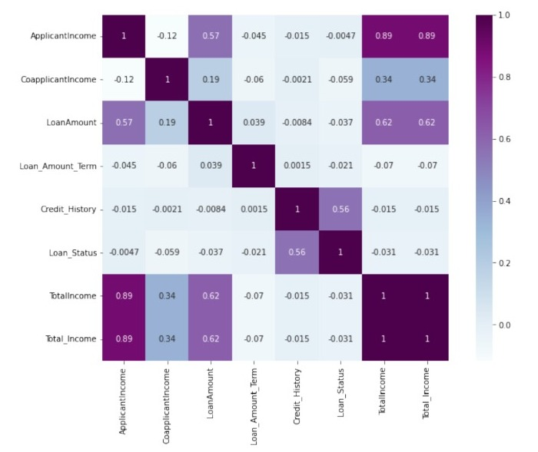
Analysis through Heat Map
Corelated Variables are:​
​
Applicant Income & Loan Amount​
​
Credit History & Loan Status​
​
Loan Amount & Co-applicant Income
Inferences :
The strongest correlation was between Credit History and Loan Status.
Total income had a good correlation with loan amount with .62 degree of correlation.
Applicant Income also showed a fair degree of correlation with the loan amount.
Co-applicant income had a very low correlation with the amount.

Slide 7



Suggested Solution
Banks should create a software and a feature on their mobile app that can determine the chances of loan approval based on the analysis done using data available.
Determine the loan amount that one can take based on the factors such as
Credit History.
Total Income.

